Slide 1
HTTP Request
Structure of the request:
start line
header field(s)
blank line
optional body

Slide 2
Start Line
Example: GET / HTTP/1.1
Three space-separated parts:
- HTTP request method
– Request-URI
– HTTP version

Slide 3
Common request methods:
– GET
• Used if link is clicked or address typed in browser
• No body in request with GET method
– POST
• Used when submit button is clicked on a form
• Form information contained in body of request

Slide 4
Uniform Resource Locator (URL)
General form: scheme:object-address
The scheme is often a communications
protocol, such as http or ftp
– For the http protocol, the object-address is:
//fully qualified domain name/doc path
– e.g. http://dwit.edu.np/content/somefile.html

Slide 5
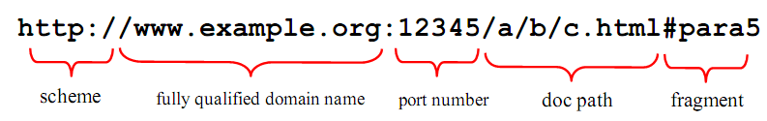
HTTP-scheme URL
Fully qualified domain name can be replaced by an IP address
Port number is by default 80
Path is partial path
Fragment is used together with in-document hypertext links

Slide 6
Locating files using URL paths
If the doc path ends with a slash, it means it is a directory
If not path is given, the server searches at the top level of the document root for something that is recognised at a homepage (normally index.html).
If no homepage is found, directory listing is returned to the browser.

Slide 7
URL document type
A URL sent to a web server can specify two types of documents:
A data file stored on the server that is to be sent to the client
XHTML files, plain text files
Video, image, audio files
A program stored on the server that the client wants to
execute, with the output of the program returned to the
client (e.g. online shopping)
.cgi, .pl, .php, .asp

Slide 8
Multipurpose Internet Mail Extensions (MIME)
Originally developed for email
Used to specify to the browser the form of a file returned by the server (attached by the server to the beginning of the document)
Type specifications
Form: type/subtype
Examples: text/plain, text/html, image/gif,
image/jpe
If the document type is not supported by the browser, helper applications or plug-ins are needed

Slide 9
Common Header Fields
Header field structure:
– field name : field value
• Common header fields:
– Host: host name from URL (required)
– User-Agent: type of browser sending request
– Accept: MIME types of acceptable documents
– Connection: value close tells server to close connection after single request/response
– Content-Type: MIME type of (POST) body, normally
application/x-www-form-urlencoded
– Content-Length: bytes in body
– Referer: URL of document containing link that supplied URI for this HTTP request

Slide 10
HTTP Response
• Structure of the response:
status line
header field(s)
blank line
optional body

Slide 11
HTTP Response
Status line
– Example: HTTP/1.1 200 OK
Three space-separated parts:
–HTTP version
–status code
–reason phrase (intended for human use)

Slide 12
Response Code
Some common HTTP status codes:
– 301 Moved Permanently
– 302 Moved Temporarily
– 307 Temporary redirect
– 401 Unauthorized
– 403 Forbidden
– 404 Not Found
– 500 Internal Server Error

Slide 13
Common header fields:
– Connection, Content-Type, Content-Length
– Date: date and time at which response was generated (required)
– Location: alternate URI if status is redirection
– Last-Modified: date and time the requested resource was last modified on the server
– Expires: date and time after which the client’s copy of the resource will be out-of-date
– ETag: a unique identifier for this version of the requested resource (changes if resource changes)

Slide 14
Cascading Style Sheet
Provides a method for web developers to separate the appearance & the content of web sites
Advantage
powerful and flexible way to specify the formatting of HTML elements
Can define font, size, background color, background image, margins, etc
Enables sharing style sheets across multiple documents or entire Web site
Efficiency: reduce development and maintenance time
enforce consistency
Helps present documents on multiple platforms (browser, cell phone, printer, …)

Slide 15

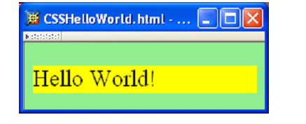
Example

Slide 16
Three types of CSS
Inline - specified for a specific occurrence of a tag and
apply only to that tag
<p style = "background-color : red">
This is fine-grained style, which defeats the purpose of
style sheets, so not recommended
Document-level - apply to the whole document in which
they appear
External - can be applied to any number of documents

Slide 17
Where are they placed
Inline - style sheets appear in the tag itself
Document-level – style sheet appear in the head of the document
<head>
<style type="text/css">
rule_list
</style>
</head>
External style sheet are in separate files, potentially on any server in the internet
<head>
<link rel="stylesheet" type = "text/css" href=“the_css_file_name.css">
</head>

Slide 18
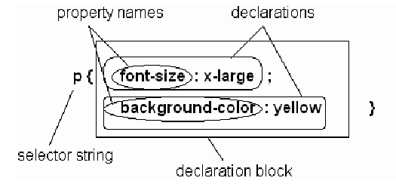
CSS Syntax
A CSS consists of one or more style rules (statements)
The structure of a style rule (or statement):
A selector string indicates elements to which the rule should apply
A declaration specifies a value for one style property of the elements

Slide 19
Selector Strings
In summary, there are 6 different types of selector strings:
• ID selector
• Class selector
• Pseudo-class selector
• Descendant selector
• Type selector
• Universal selector

Slide 20
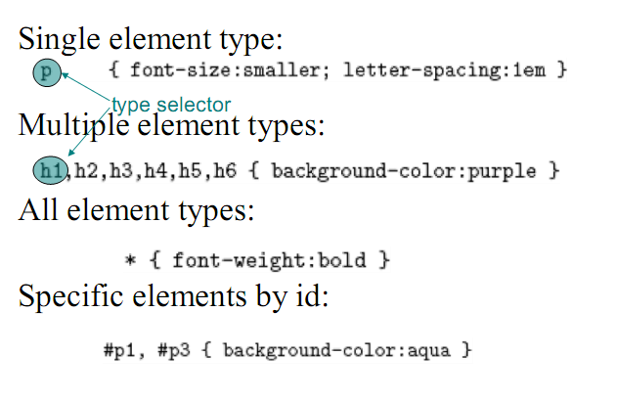
Selector Strings

Slide 21
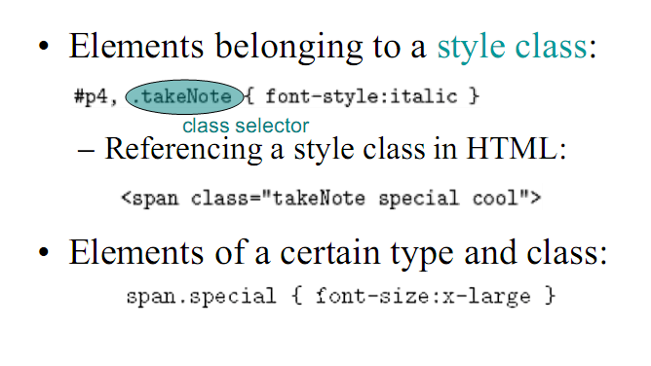
Class in CSS

Slide 22
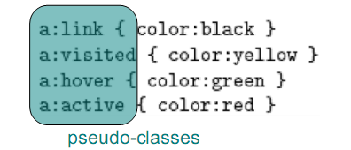
Psuedo class
Pseudo-classes: styles that apply when something happens, e.g. Source anchor elements

Slide 23
Property Categories
There are properties in 7 categories:
• Font
• Color
• List
• Alignment
• Margin
• Background
• Border

Slide 24

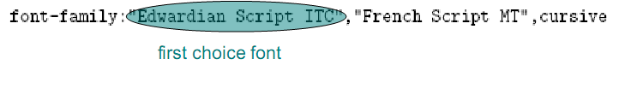
CSS Font Properties
A font family is a collection of related fonts
(typically differ in size, weight, etc.)
font-family property can accept a list of
families, including generic font families

Slide 25
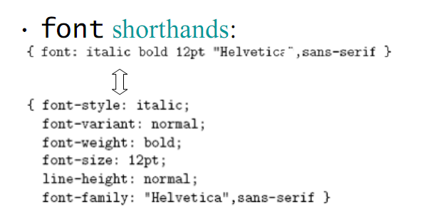
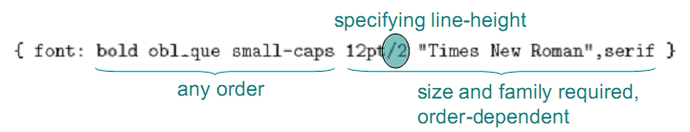
CSS Font Properties

Slide 26
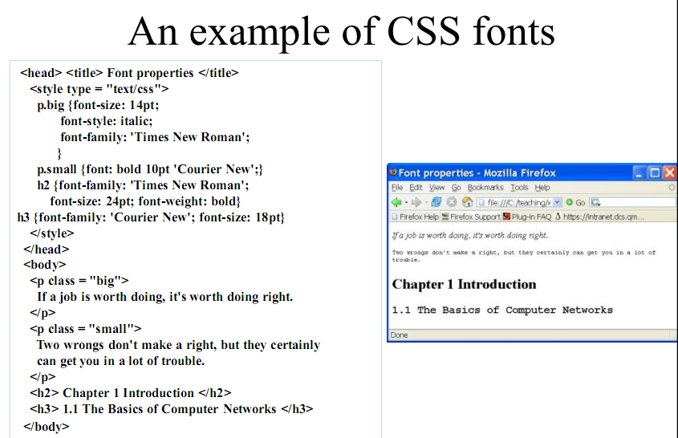

Slide 27
